Slide 1
ADVANCED VEHICLE BLACKBOX
Jose Garza, Prisha Srivastava, Lide Su, Christian Loth

Slide 2
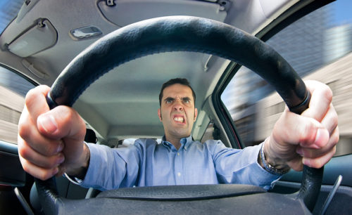
Problem Background
Chances of collision increase as drivers perform unsafe maneuvers.
Drivers are unaware of their driving behaviours.
Insurance companies charge for insurance based on assumptions of age and car model. Creates unfair system.
Accidents are preventable.

Slide 3
Goals and Objectives
The goal of this project is to encourage healthy and responsible driving practices through automated, real-time monitoring systems. Incorporating a user-specific interface creates an accurate profile such that it increases self-awareness. We hope that by creating a time sensitive profile algorithm, we are able to realistically grasp a driver’s current driving behavior and through consistent monitoring, reduce their chances of collisions or accidents.

Slide 4



vBox Requirements
vBox incorporates a custom algorithm that detects the quality of drive in order to detect safe and unsafe driving practices.
vBox effectively and constantly gathers data from its sensors in order to have enough information to draw conclusions of the driving behaviors.
vBox collects real-time data to consistently monitor behavior to improve behaviors with realistic approach.
vBox creates separate driver profiles to uniquely identify and cater users of different ages, experience driving in different road conditions in order to accurately identify and advise on their drive.

Slide 5
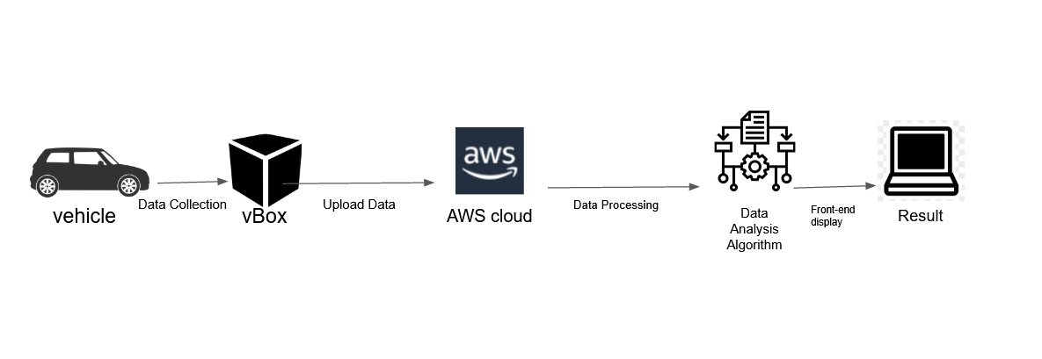
High Level Block Design

Slide 6
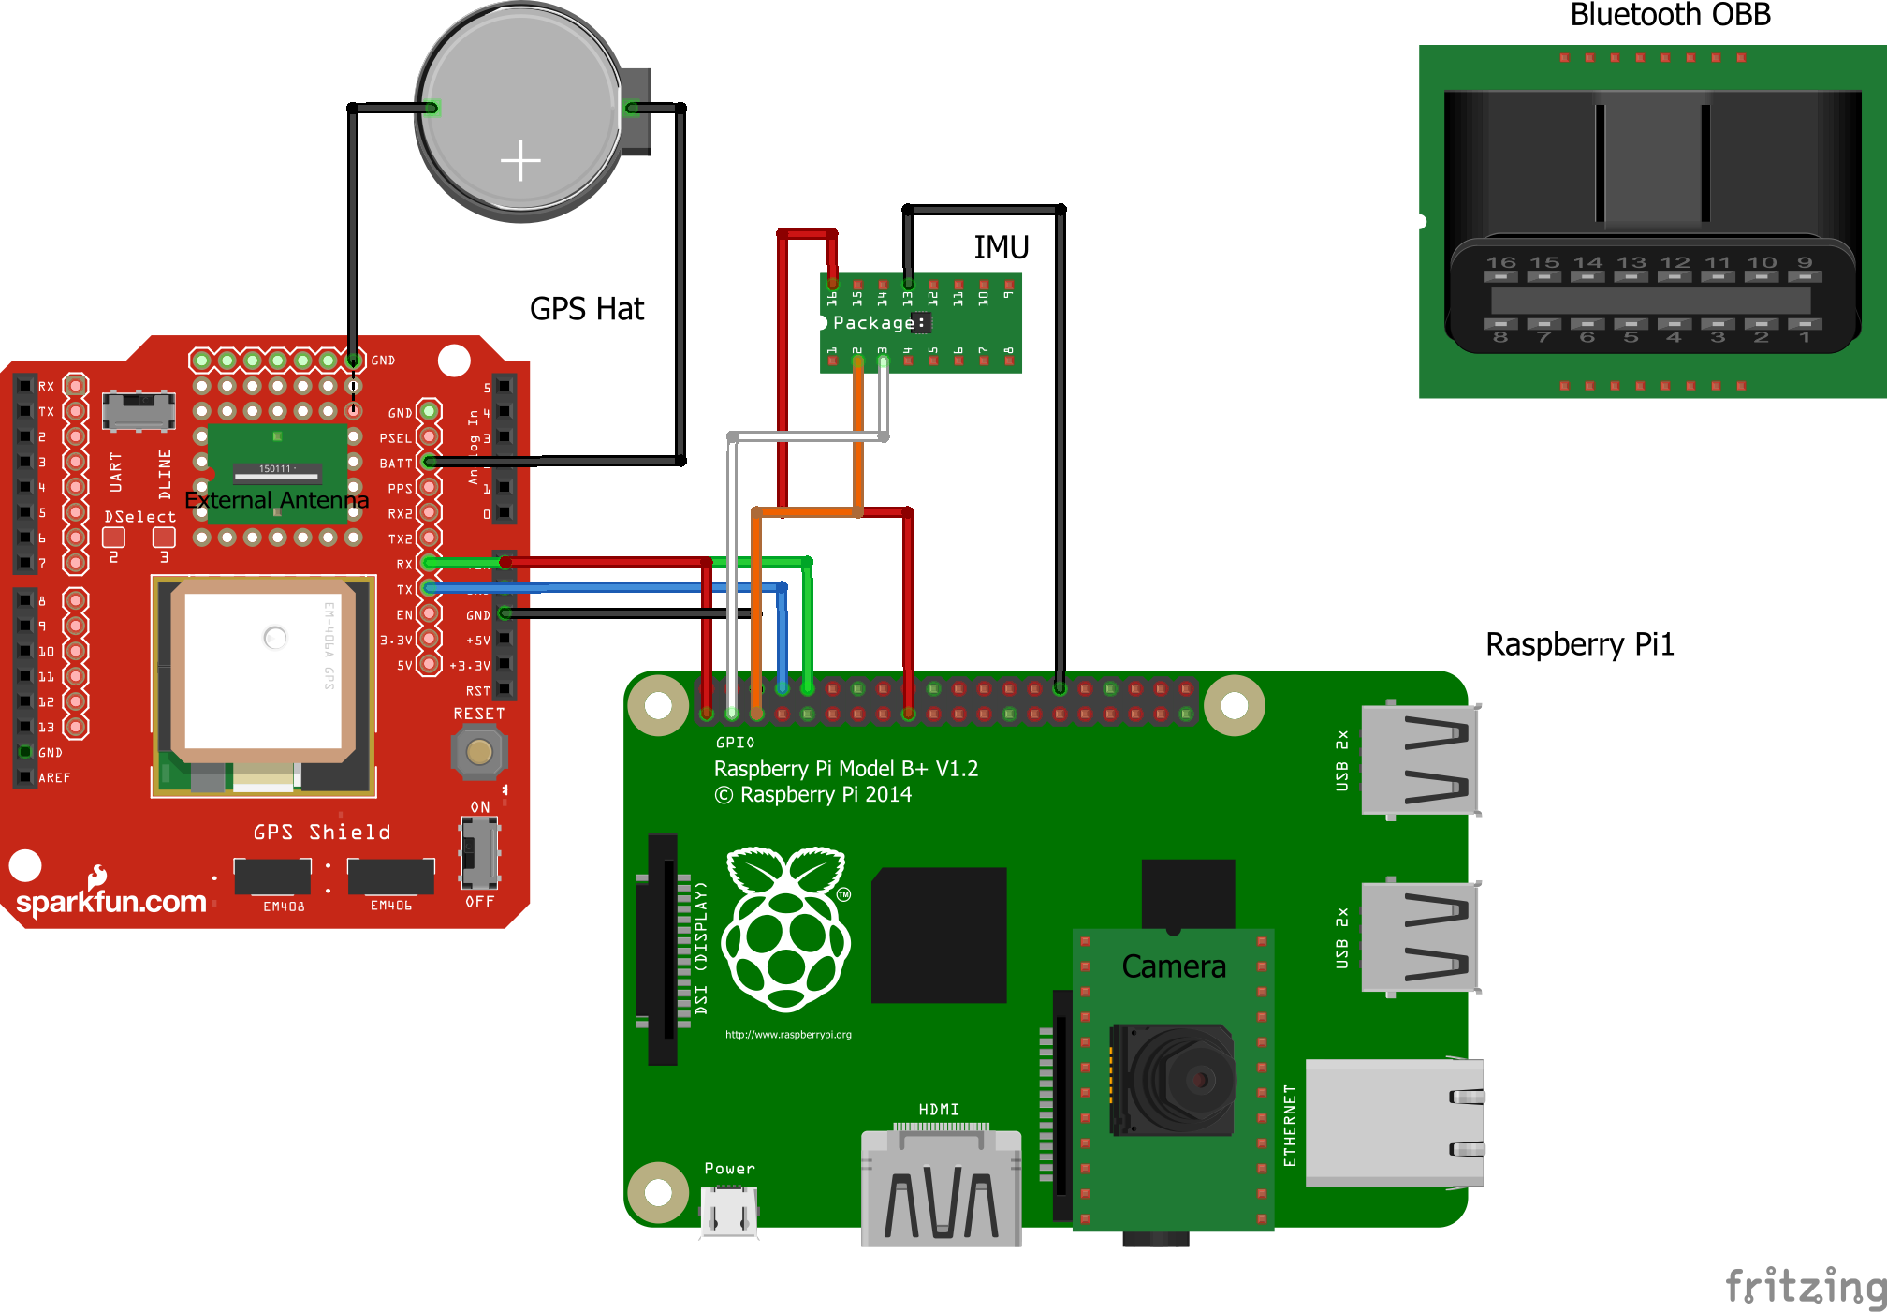
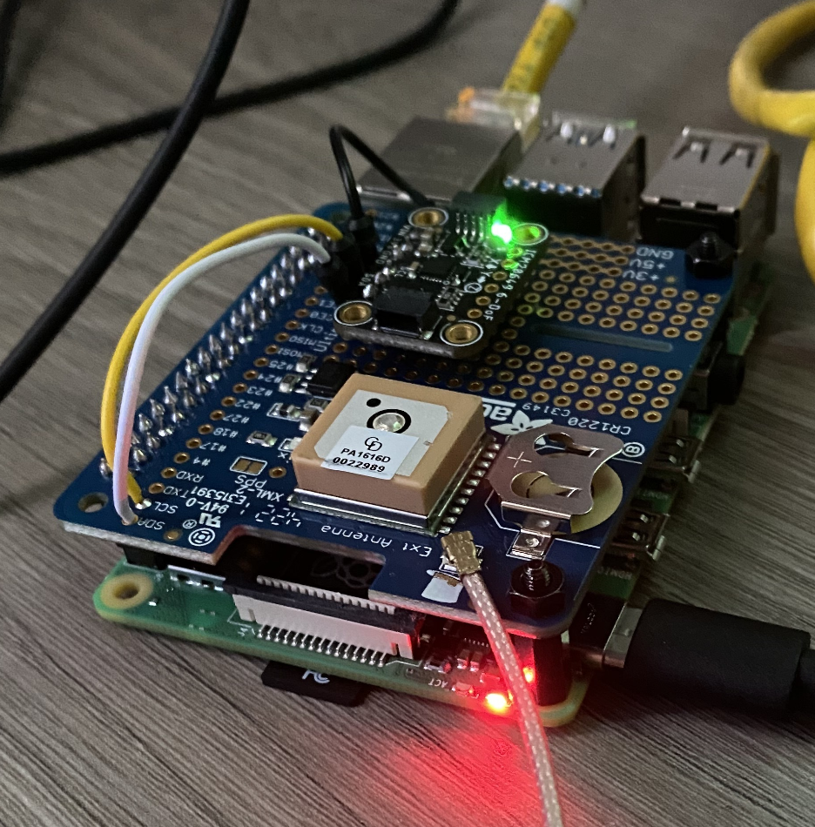
Sensor Connections

Slide 7
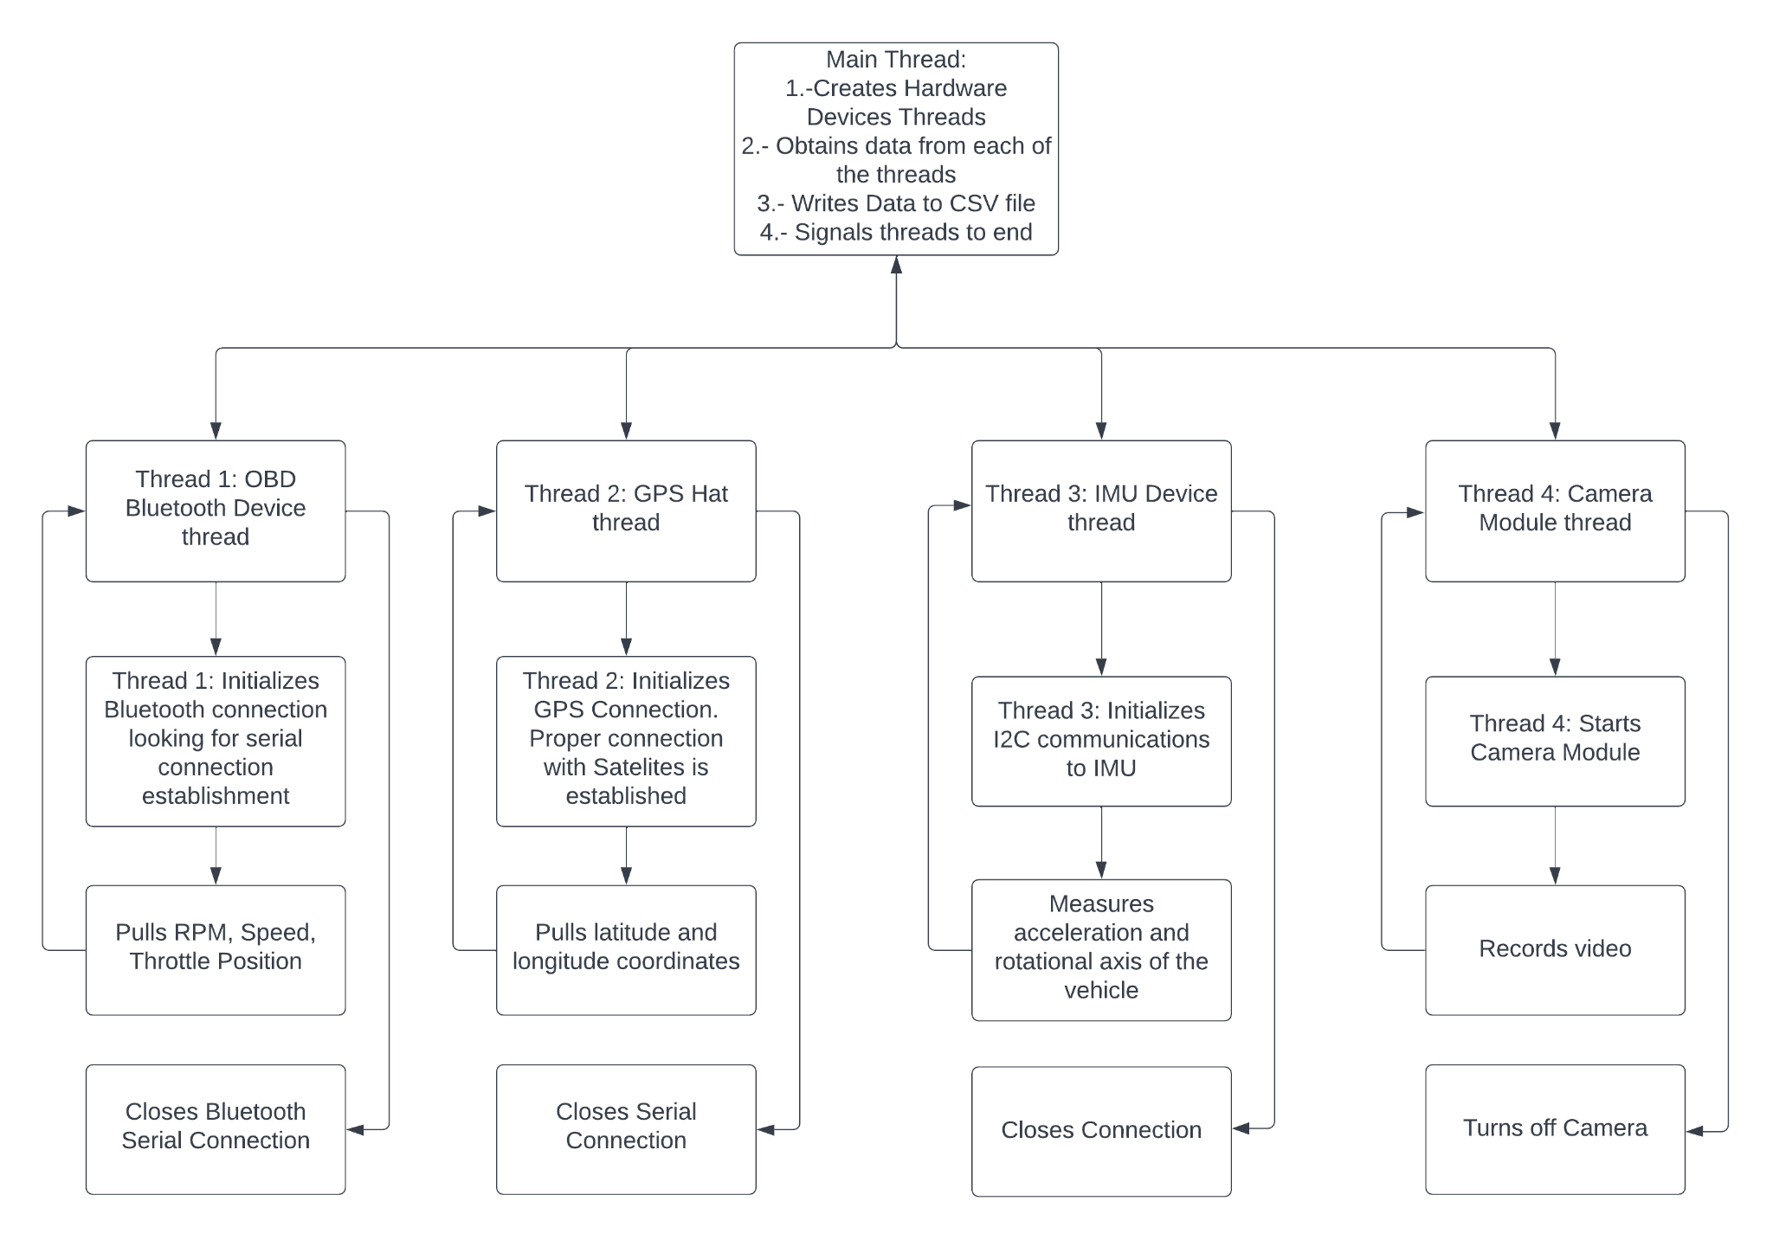
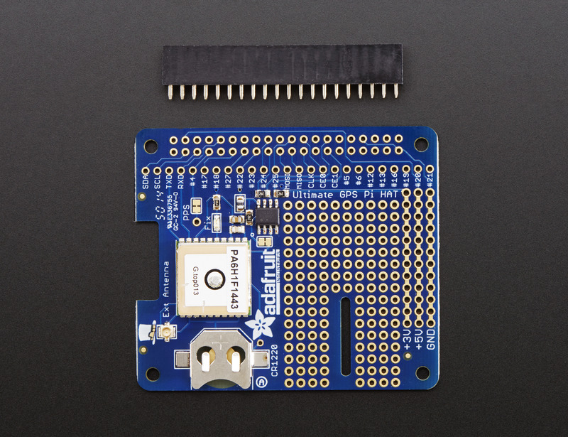
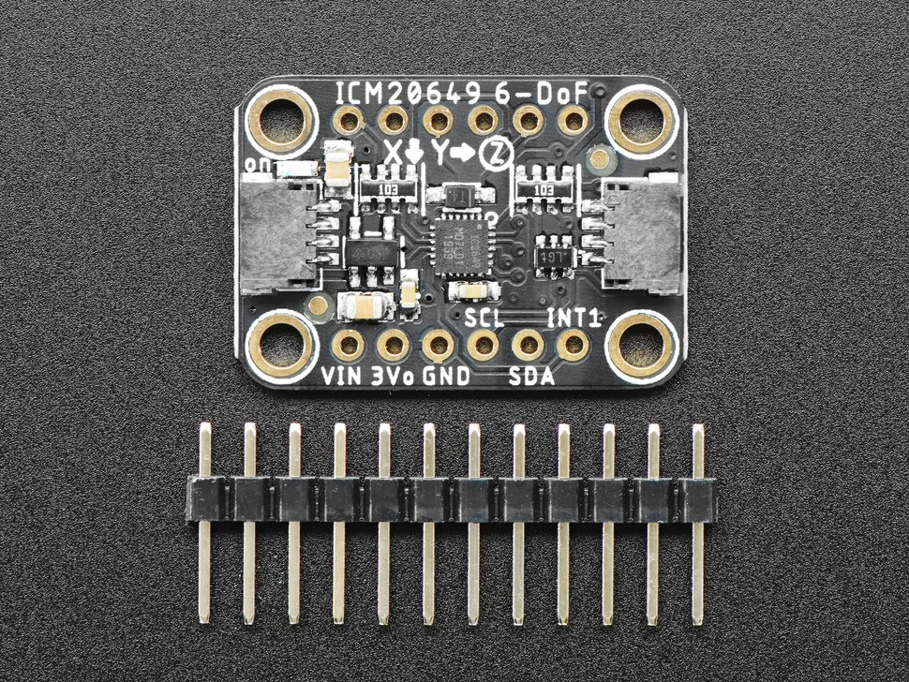
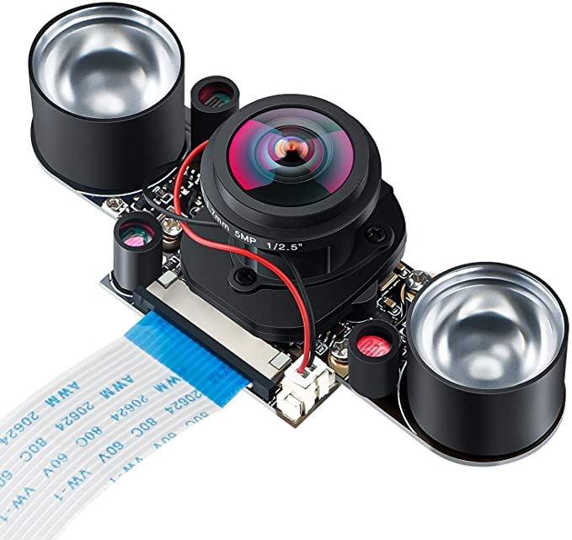
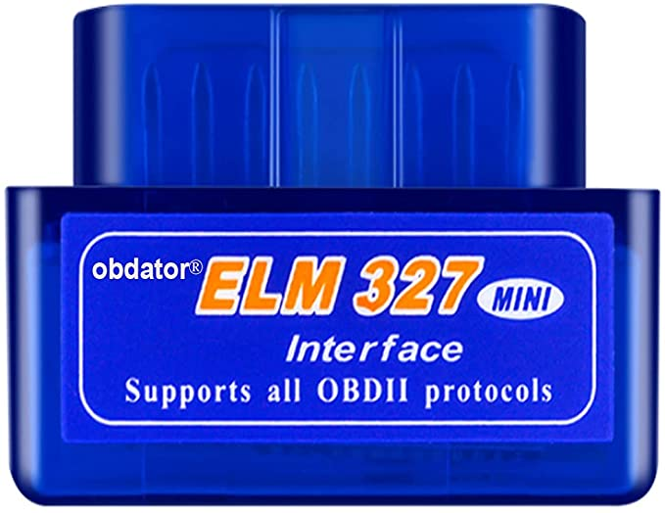
Software Sensor Data Retrieval

Slide 8
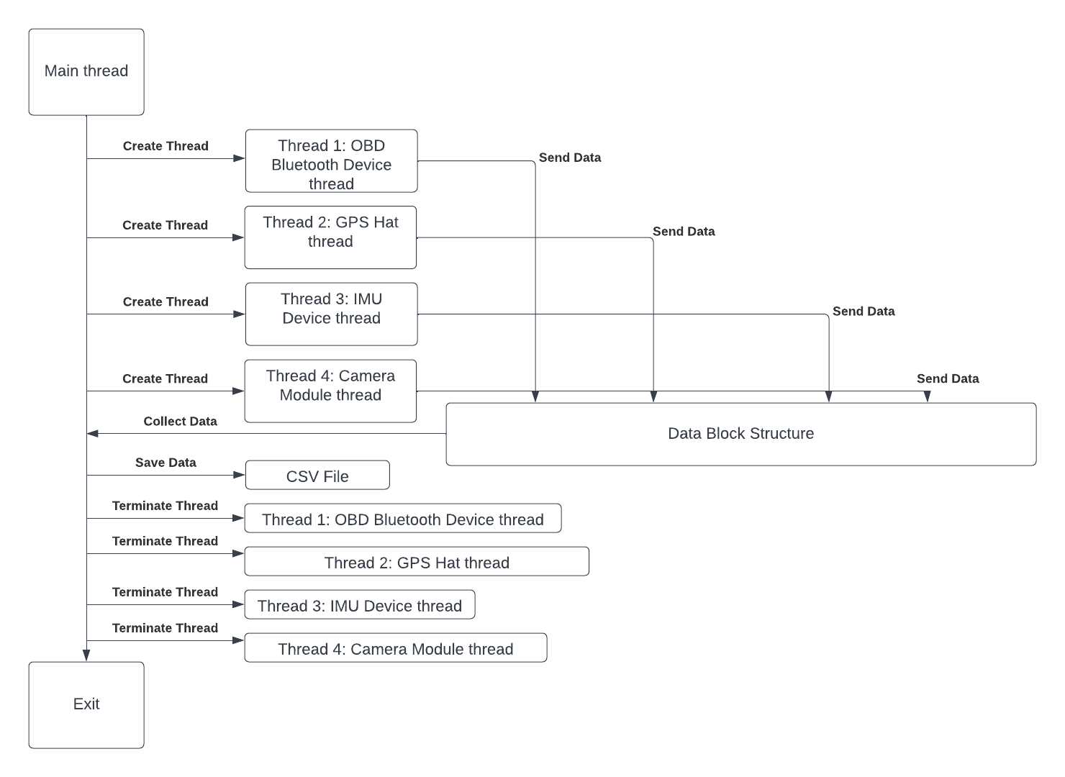
Software Sensor Data Retrieval

Slide 9
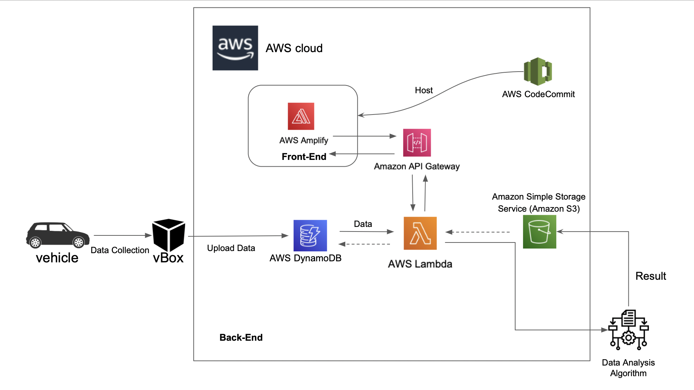
Embedded System

Slide 10
Evaluation of alternative solutions
USB OBD
Would require another cable running from the OBD port which is located under the steering wheel to the Raspberry Pi in the windshield.
Standalone GPS (no external antenna)
Would not provide accurate GPS readings. In some cases the “FIX” takes up to 30 minutes in closed spaces due to the poor integrated antenna. This led to the necessity of an external antenna.
Standard IMU
IMU lacks insight from road conditions (i.e bumpy, traffic giving inconsistent speed reading) needed for an advanced driving detection system.
GPS based Web Platform
Location tracking and speed detection through GPS may lack context in situations where driving above or below the speed limit is realistic. Speed is not as accurate as the speed of the car ECU.
Real Time Data Upload
Would increase complexity and costs by adding another module.

Slide 11
Approach for design validation
Our design is intended to transition from prototype to final deployment through a series of layered testing that allows us to thoroughly examine the functionality of hardware and software aspects of our project.
Embedded Hardware System
Run simple python commands on Raspi terminal to check each sensor status.
Generate terminal output of sensor readings.
Use multimeter to check soldering connection.
Web App Software Testing
Using Agile Methodology for software development.
Local testing of web application to test if profile data exists and is valid.
Front-end testing to verify if DynamoDB datasets are displayed correctly.
Receives analysis output from backend script and presents on the application through visuals and real-time record.
Back-end Algorithm Testing
Using 6 testing scenarios (or “switch cases”), different in observed speed and road type, a prediction model identifies certain points and calculated average score for the trip.
Required variables are satisfied by retrieving data from database for the execution of program
Score and Analysis is sent over to Webapp through API calls to server
Input variables are split between using dummy data points and user-generated values.

Slide 12
Economic Analysis
Description | Price | Quantity
Raspberry Pi 4 Camera | $24.59 | 1
Adafruit GPS Hat | $29.95 | 1
External GPS antenna | $19.95 | 1
IMU (Accelerometer & Gyro) | $14.95 | 1
Standoffs for Pi HATs | $0.75 | 1
RF Adapter cable | $3.95 | 1
Bluetooth interface OBD port | $13.99 | 1
Raspberry Pi 4 | $167.95 | 1
SD card with 512 GB | $29.99 | 1
Car charger for Raspberry Pi 4 | $14.44 | 1
Suction Cup Mount | $24.99 | 1
3D Printed Enclosure | $25.00 | 1
The parts originally ordered have been able to achieve the desired results.
Camera module has not been delivered to the team.
Total = $345.50

Slide 13
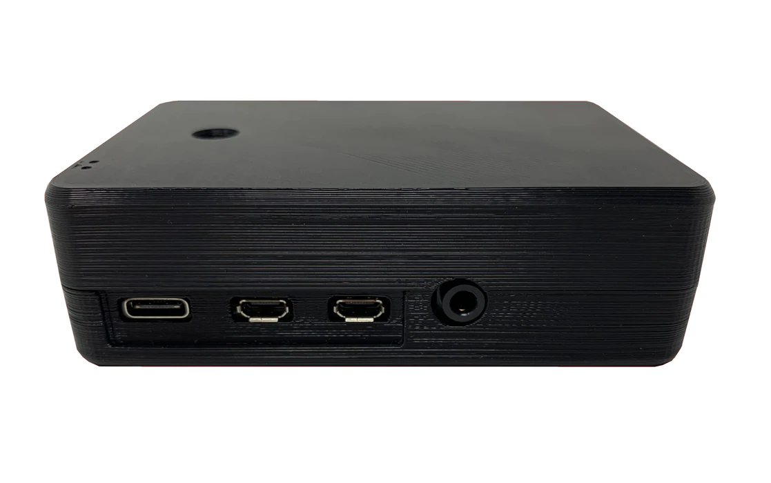
Manufacturability, Sustainability and Economics of vBox
Manufacturability:
Product will use SLA resin to create a thermoset case for the Raspberry Pi.
Sustainability:
3-D printing produces more sustainable solutions than traditional manufacturing methods.
70-90% less scrap waste.
41-64% less energy consumed.
Economics of vBox:
Cost of Production: $345.50, RasPi 4 is 4.8 times more expensive than usual price.
Bulk Purchase of items would significantly reduce cost for larger-scale production.

Slide 14
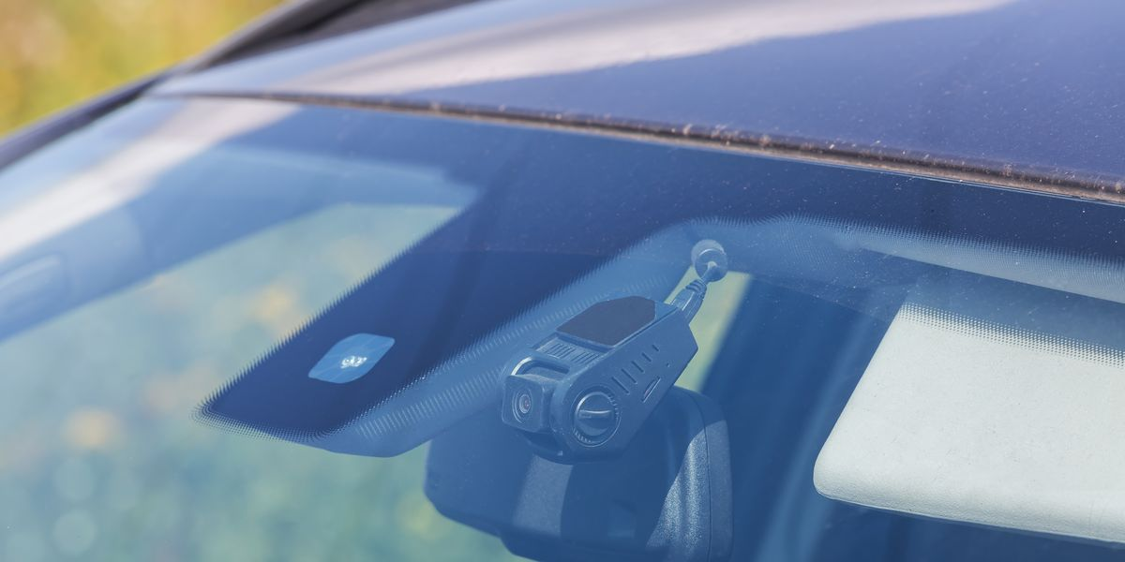
Health/Societal/Political Concerns
Social
Society benefits directly from reduced poor driving practices -- more saved lives.
Blackbox will be manufactured in a compact design such that driver's ability to drive is not impacted by the device.
Reduce the amount of crashed cars. Reducing the amount of cars that are deemed totaled.
Political
Road Safety continues to be a high-priority political topic for countries i.e Spain and Italy
Previously, many road safety public policies include more resources for police enforcement/traffic management, these policies are hardly effective without required funding.
Automating driving assessment and creating custom profiling system provides a cheaper alternative to monitoring road safety.
Ethical
The more lives we save, the more ethical it is. We can save more lives by knowing the problem that caused a crash.
It is also ethical to have more safe drivers, and reduce untrained drivers to make our roads much safer for everybody.

Slide 15
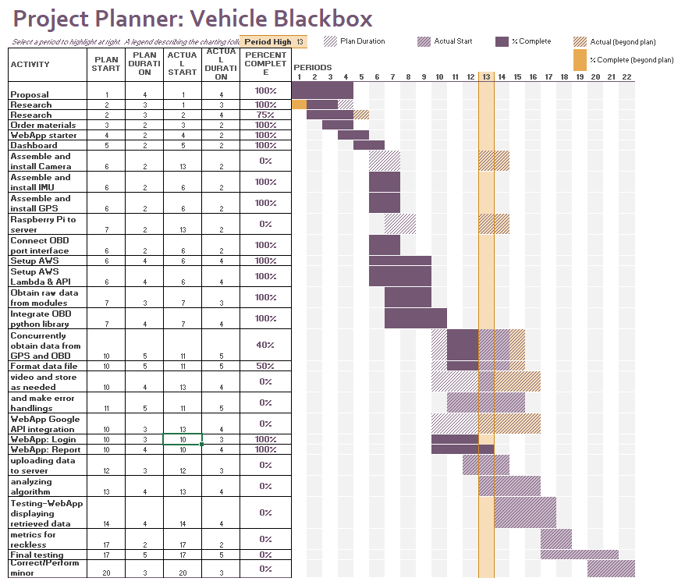
Schedule of tasks
Project is on schedule
Major tasks to be completed:
Software: Add integration of the Google API. Design improvements /options to WebApp.
Hardware: Establish a script to upload CSV file to the cloud. Handle errors in data.
Data Analytics: Determine algorithm to score the drivers’ behaviors.
All: Testing and debugging of the system.

Slide 16




Project Management and teamwork
Hardware
Software
Receiving the parts ordered and soldering the necessary parts.
Establishing a connection between each one of the components.
Integrating the module connections together for a more compact device.
Establish basic python scripts to test the connection between the devices.
Establishing the CSV file format
Established AWS DynamoDB.
Implemented Lambda functions and API gateway.
Established connection from React app to AWS Amplify to host web app online.
Made significant progress with designing the dashboard that the users see of the WebApp.
Added different graphs and different attributes to the webpage.

Slide 17
Future Tasks Distribution
Hardware
Data Analytics
Software
Upload data to the server and ensure proper formatting and error handling.
Develop an algorithm to score the drivers’ behavior
Upload data from Raspberry Pi to AWS DynamoDB.
Integrate Google API
Design Improvements and settings.

Slide 18
Demo

Slide 19
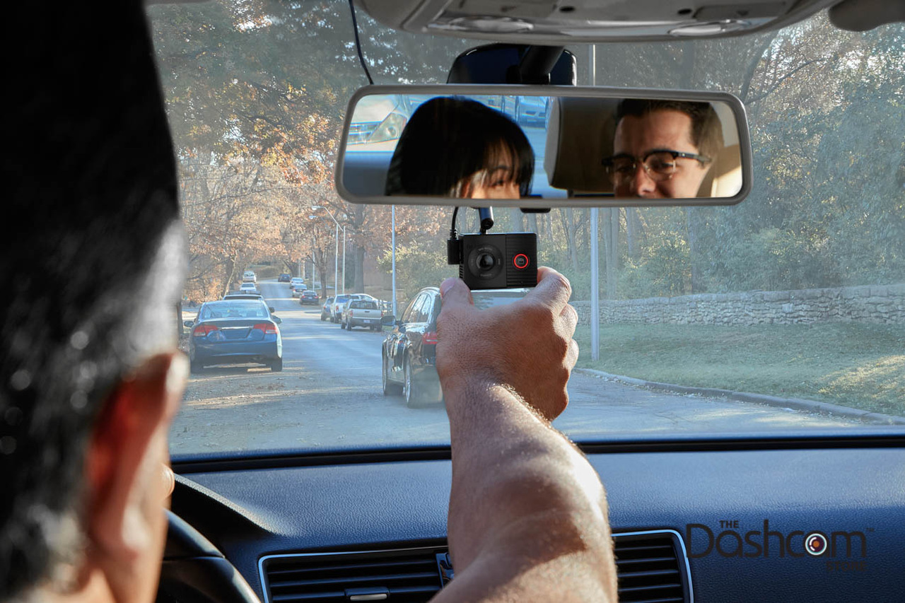
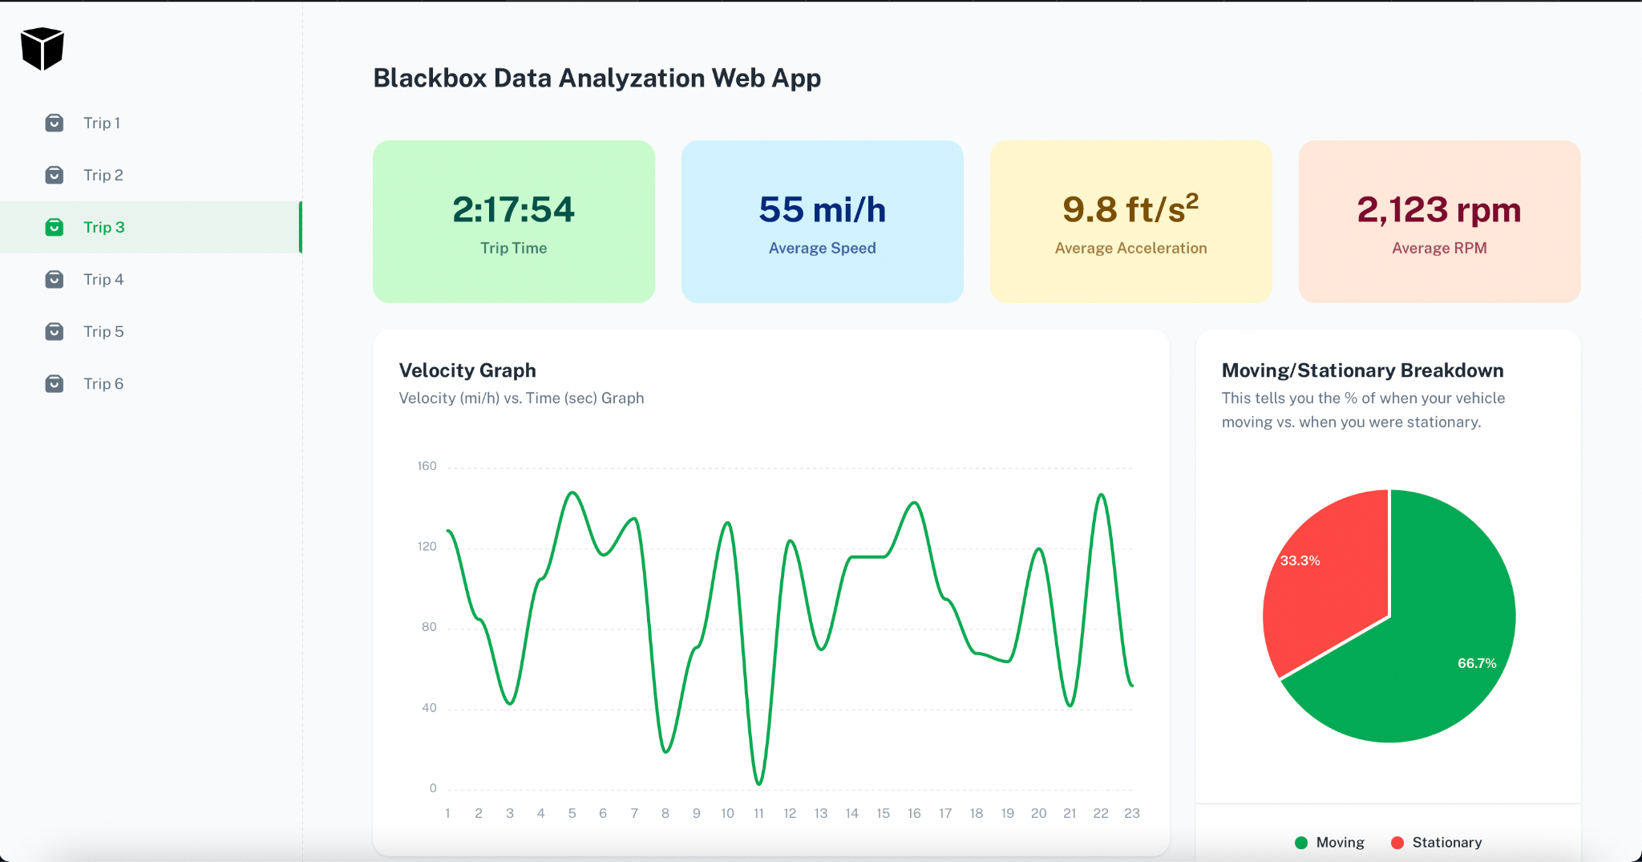
Future Final Demonstration
Recorded Demo
Live Demo
Using OBD emulator
ELM327-emulator - Python based. Used for the development of OBD reading applications.
Would permit a live demonstration through a series of recorded input to the devices.
Record the experience of a normal user and upload the data to the webpage which can be displayed
Would demonstrate a physical use scenario

Slide 20
We appreciate your attention
Questions?

